Slide 1


Introduction to Operating Systems CS 1550
Spring 2023
Sherif Khattab
ksm73@pitt.edu
(Some slides are from Silberschatz, Galvin and Gagne ©2013)

Slide 2
Announcements
Upcoming deadlines
All deadlines moved to Monday May 1st at 11:59 pm
But please don’t wait to last minute!
Homework 11, 12, Bonus Homework
Lab 4 and Lab 5
Quiz 3 and Quiz 4
Project 4 (no late deadline)
Post-Course Quiz (1 bonus point)
Bonus point for all class when OMET response rate >= 80%
Currently at 5%
Deadline: 4/23

Slide 3
Previous Lecture …
How does a file system handle errors?

Slide 4
This lecture …
How does a file system hide disk access delays?
How do device drivers program I/O devices?

Slide 5
Question of the Day – Part 1
How does a file system hide disk access delays?
Answer:
Optimize disk reads
Caching
Optimize disk writes
log structured file system

Slide 6
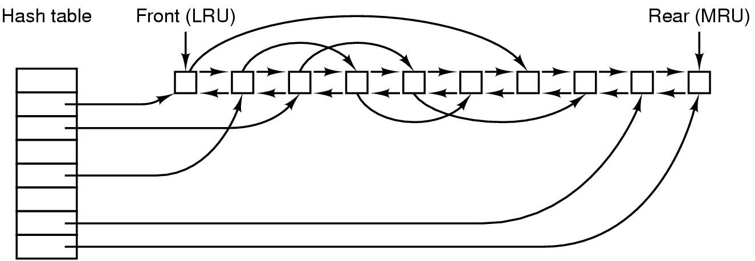
Disk block cache: data structures

Slide 7
Side effects of caching
Larger memory sizes → disk block caches are larger
Increasing number of read requests come from cache
Thus, most disk accesses will be writes

Slide 8
Optimize Disk Writes: Log-structured file systems
Log-structured file system (LFS)
structures entire disk as a log
writes are always appends
writes initially buffered in memory
Periodically write these to the end of the disk
What if a block is updated?
Ignore the old version of the block
write the new version to the end of the disk
write a new i-node to point to the new block versions
Issue: what happens when blocks are deleted?

Slide 9
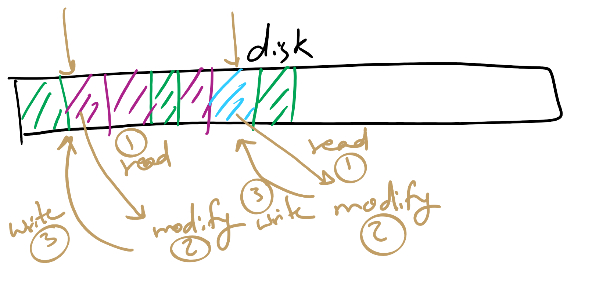
Conventional File System
When a block is updated
Read block to memory (if not already in cache)
Modify block in memory
Write block back to same location on disk

Slide 10




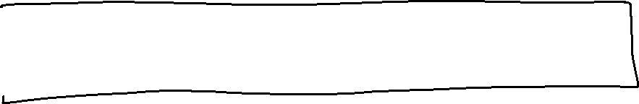



Log-structured File System
When a block is updated

Slide 11






Log-structured File System
When a block is updated
Read block to memory (if not already in cache)

Slide 12

Log-structured File System
When a block is updated
Read block to memory (if not already in cache)
Modify block in memory

Slide 13







Log-structured File System
When a block is updated
Read block to memory (if not already in cache)
Modify block in memory
Append block to end of disk

Slide 14
Log-structured File System
When a block is updated
Read block to memory (if not already in cache)
Modify block in memory
Append block to end of disk
Create a new i-node pointing to the new block versions
The process is process for all modified disk blocks
including the blocks for the i-nodes and
directories to point to the new i-nodes

Slide 15
Log-structured File System
Disks will get full faster
Solution:
Allow users to go back in time to older versions of files and directories
since they all already exist on disk
Turn a bug into a feature!

Slide 16
Log-structured File System
Idea of LFS turns to work well for Solid State Disks!

Slide 17
Solid State Disks in a nutshell
SSD divided into erasure blocks
Erasure blocks divided into pages
pages contain cells
pages are read and written individually
fast operation
The entire erasure block erased before any page can be written
erasing (aka flashing) is a slow operation
affects durability of the disk

Slide 18
Updating data on SSDs
To modify a flash-disk page:
read block into memory
modify page in memory
erase block on disk
write modified block

Slide 19
Wear Leveling in SSDs
Wear Leveling
balance number of flash operations across disk blocks

Slide 20
Problem of the Day – Part 2
How do device drivers program I/O devices?
Answer: three methods
polling
Interrupts
DMA

Slide 21
How are I/O devices connected?
Single-bus
All memory accesses go over a shared bus
I/O and RAM accesses compete for bandwidth
Dual-bus
RAM access over high-speed bus
I/O access over lower-speed bus
Less competition
More hardware (more expensive…)
CPU
Memory
I/O
CPU
Memory
I/O
This port allows I/O devices access into memory

Slide 22
Memory-Mapped vs. separate I/O Space
Memory
0xFFF…
I/O ports
0
Separate I/O & memory space
Memory-mapped I/O
Hybrid: both memory-mapped & separate spaces

Slide 23
Example: Dynamic Frequency on XScale

Slide 24
Programmed I/O example: printing a page
User
Printed page
Printed page
Printed page
ABCD EFGH
ABCD EFGH
ABCD EFGH
A
AB
Kernel
ABCD EFGH
ABCD EFGH

Slide 25
Polling
copy_from_user (buffer, p, count); // copy into kernel buffer
for (j = 0; j < count; j++) { // loop for each char
while (*printer_status_reg != READY)
; // wait for printer to be ready
*printer_data_reg = p[j]; // output a single character
}
return_to_user();

Slide 26
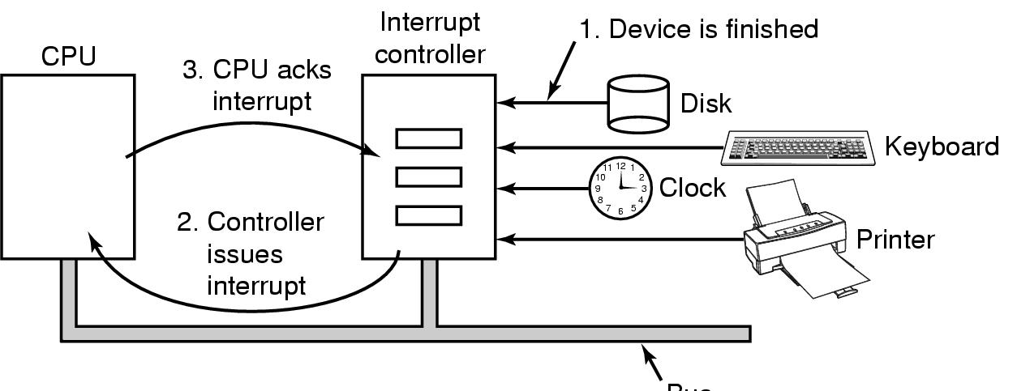
Hardware’s view of interrupts
Bus

Slide 27
Interrupt-driven I/O
copy_from_user (buffer, p, count);
j = 0;
enable_interrupts();
while (*printer_status_reg != READY)
;
*printer_data_reg = p[0];
scheduler(); // and block user
Code run by system call
if (count == 0) {
unblock_user();
} else {
j++;
*printer_data_reg = p[j];
count--;
}
acknowledge_interrupt();
return_from_interrupt();
Code run at interrupt time
(Interrupt handler)

Slide 28
Polling
copy_from_user (buffer, p, count); // copy into kernel buffer
for (j = 0; j < count; j++) { // loop for each char
while (*printer_status_reg != READY)
; // wait for printer to be ready
*printer_data_reg = p[j]; // output a single character
}
return_to_user();

Slide 29
Hardware’s view of interrupts
Bus

Slide 30
Interrupt-driven I/O
copy_from_user (buffer, p, count);
j = 0;
enable_interrupts();
while (*printer_status_reg != READY)
;
*printer_data_reg = p[0];
scheduler(); // and block user
Code run by system call
if (count == 0) {
unblock_user();
} else {
j++;
*printer_data_reg = p[j];
count--;
}
acknowledge_interrupt();
return_from_interrupt();
Code run at interrupt time
(Interrupt handler)

Slide 31
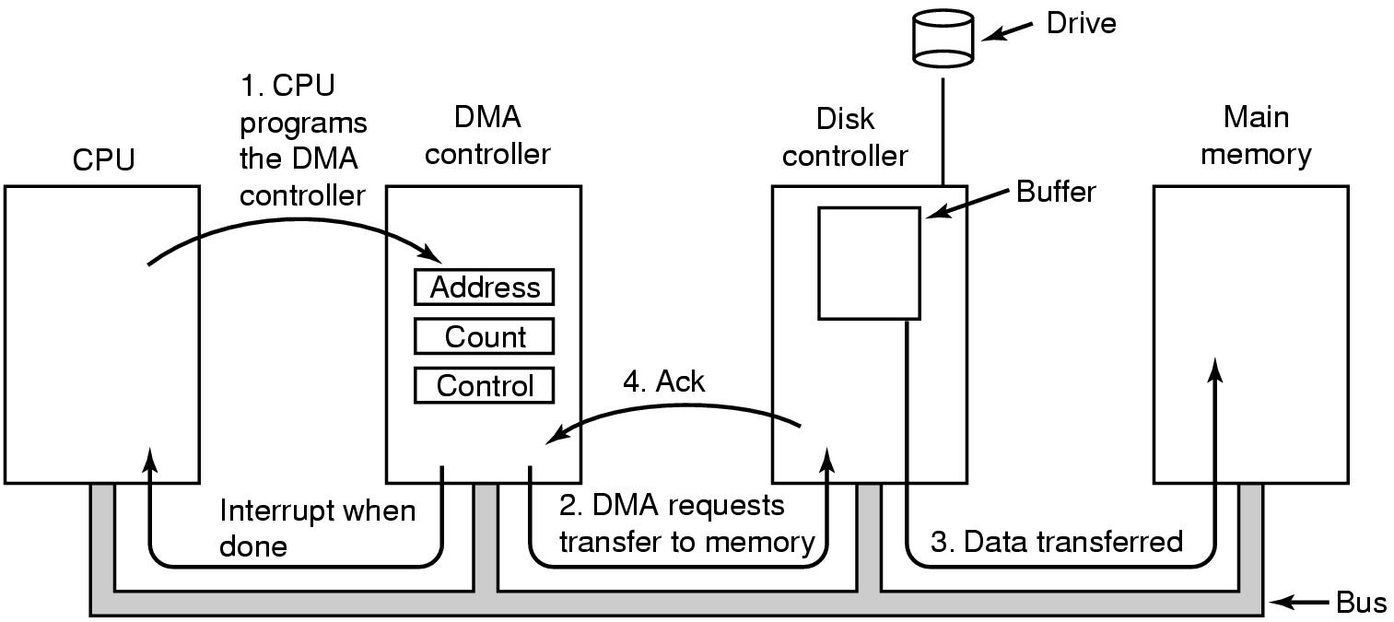
Direct Memory Access (DMA) operation

Slide 32
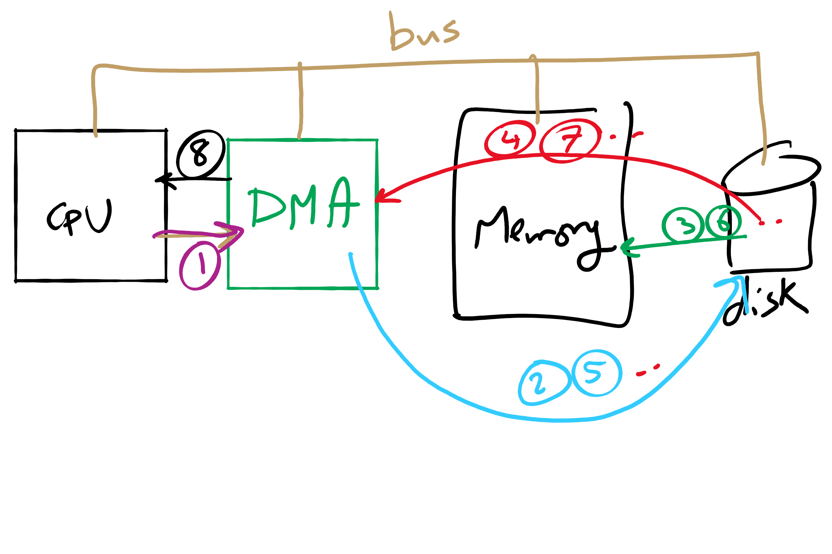
DMA

Slide 33
I/O using DMA
copy_from_user (buffer, p, count);
set_up_DMA_controller();
scheduler(); // and block user
Code run by system call
acknowledge_interrupt();
unblock_user();
return_from_interrupt();
Code run at interrupt time

Slide 34
Disk drive structure
Data stored on surfaces
Up to two surfaces per platter
One or more platters per disk
Data in concentric tracks
Tracks broken into sectors
256B-1KB per sector
Cylinder: corresponding tracks on all surfaces
Data read and written by heads
Actuator moves heads
Heads move in unison
head
sector
platter
track
cylinder
surfaces
spindle
actuator

Slide 35
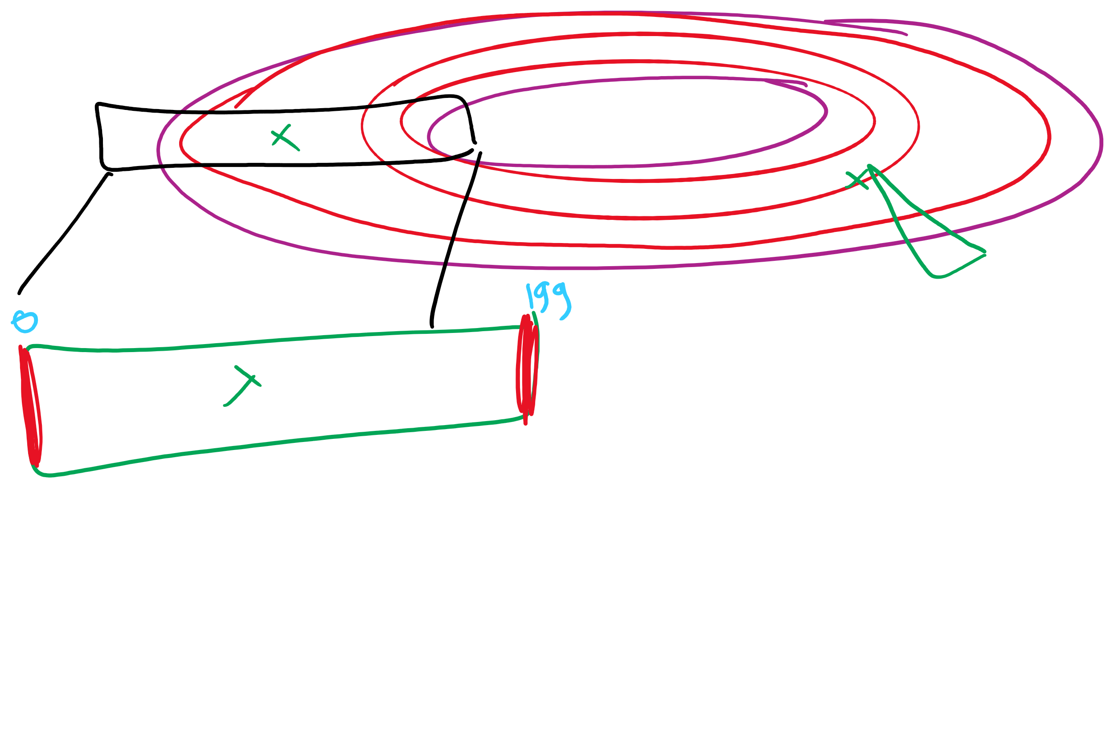
Disk scheduling algorithms
Schedule disk requests to minimize disk seek time
Seek time increases as distance increases (though not linearly)
Minimize seek distance -> minimize seek time
Disk seek algorithm examples assume a request queue & head position (disk has 200 cylinders)
Queue = 100, 175, 51, 133, 8, 140, 73, 77
Head position = 63
Outside edge
Inside edge
8
51
73
100
133
175
77
140
read/write head position
disk requests
(cylinder in which block resides)

Slide 36
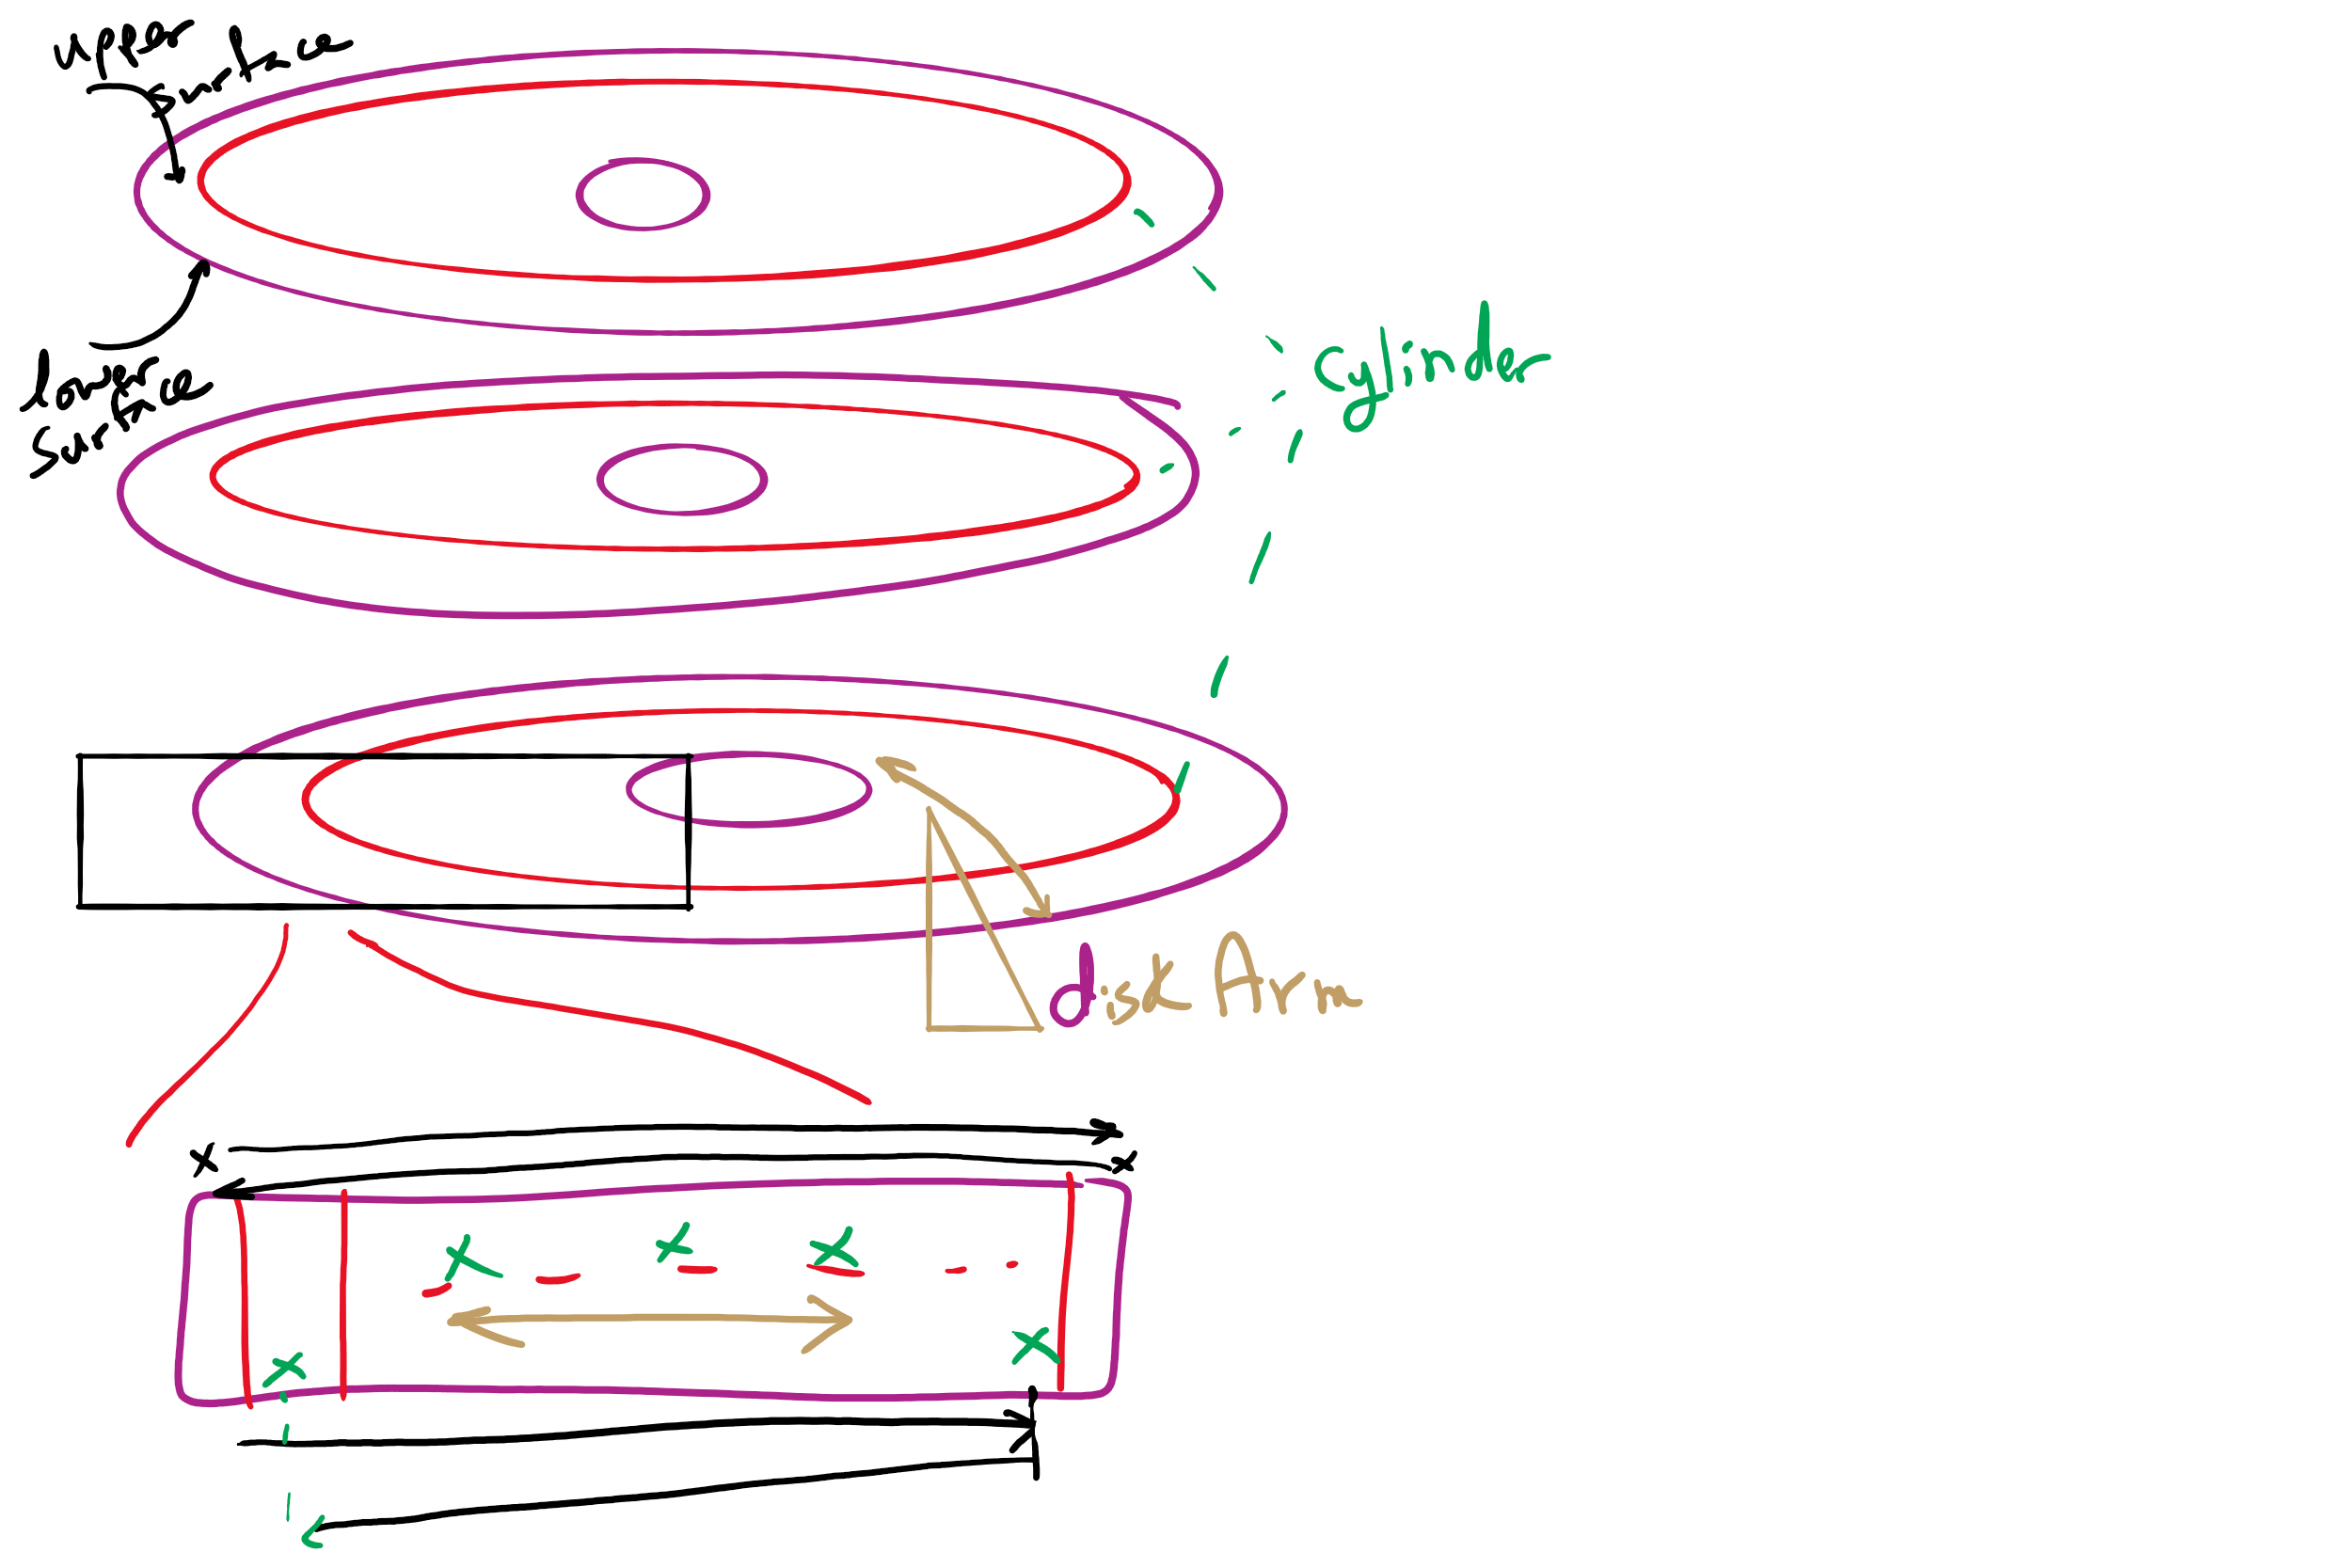
Disk Arm Scheduling

Slide 37
First-Come-First Served (FCFS)
Requests serviced in the order in which they arrived
Easy to implement!
May involve lots of unnecessary seek distance
Seek order = 100, 175, 51, 133, 8, 140, 73, 77
Seek distance = (100-63) + (175-100) + (175-51) + (133-51) + (133-8) + (140-8) + (140-73) + (77-73) = 646 cylinders
read/write head start
100
175
51
133
8
140
73
77

Slide 38
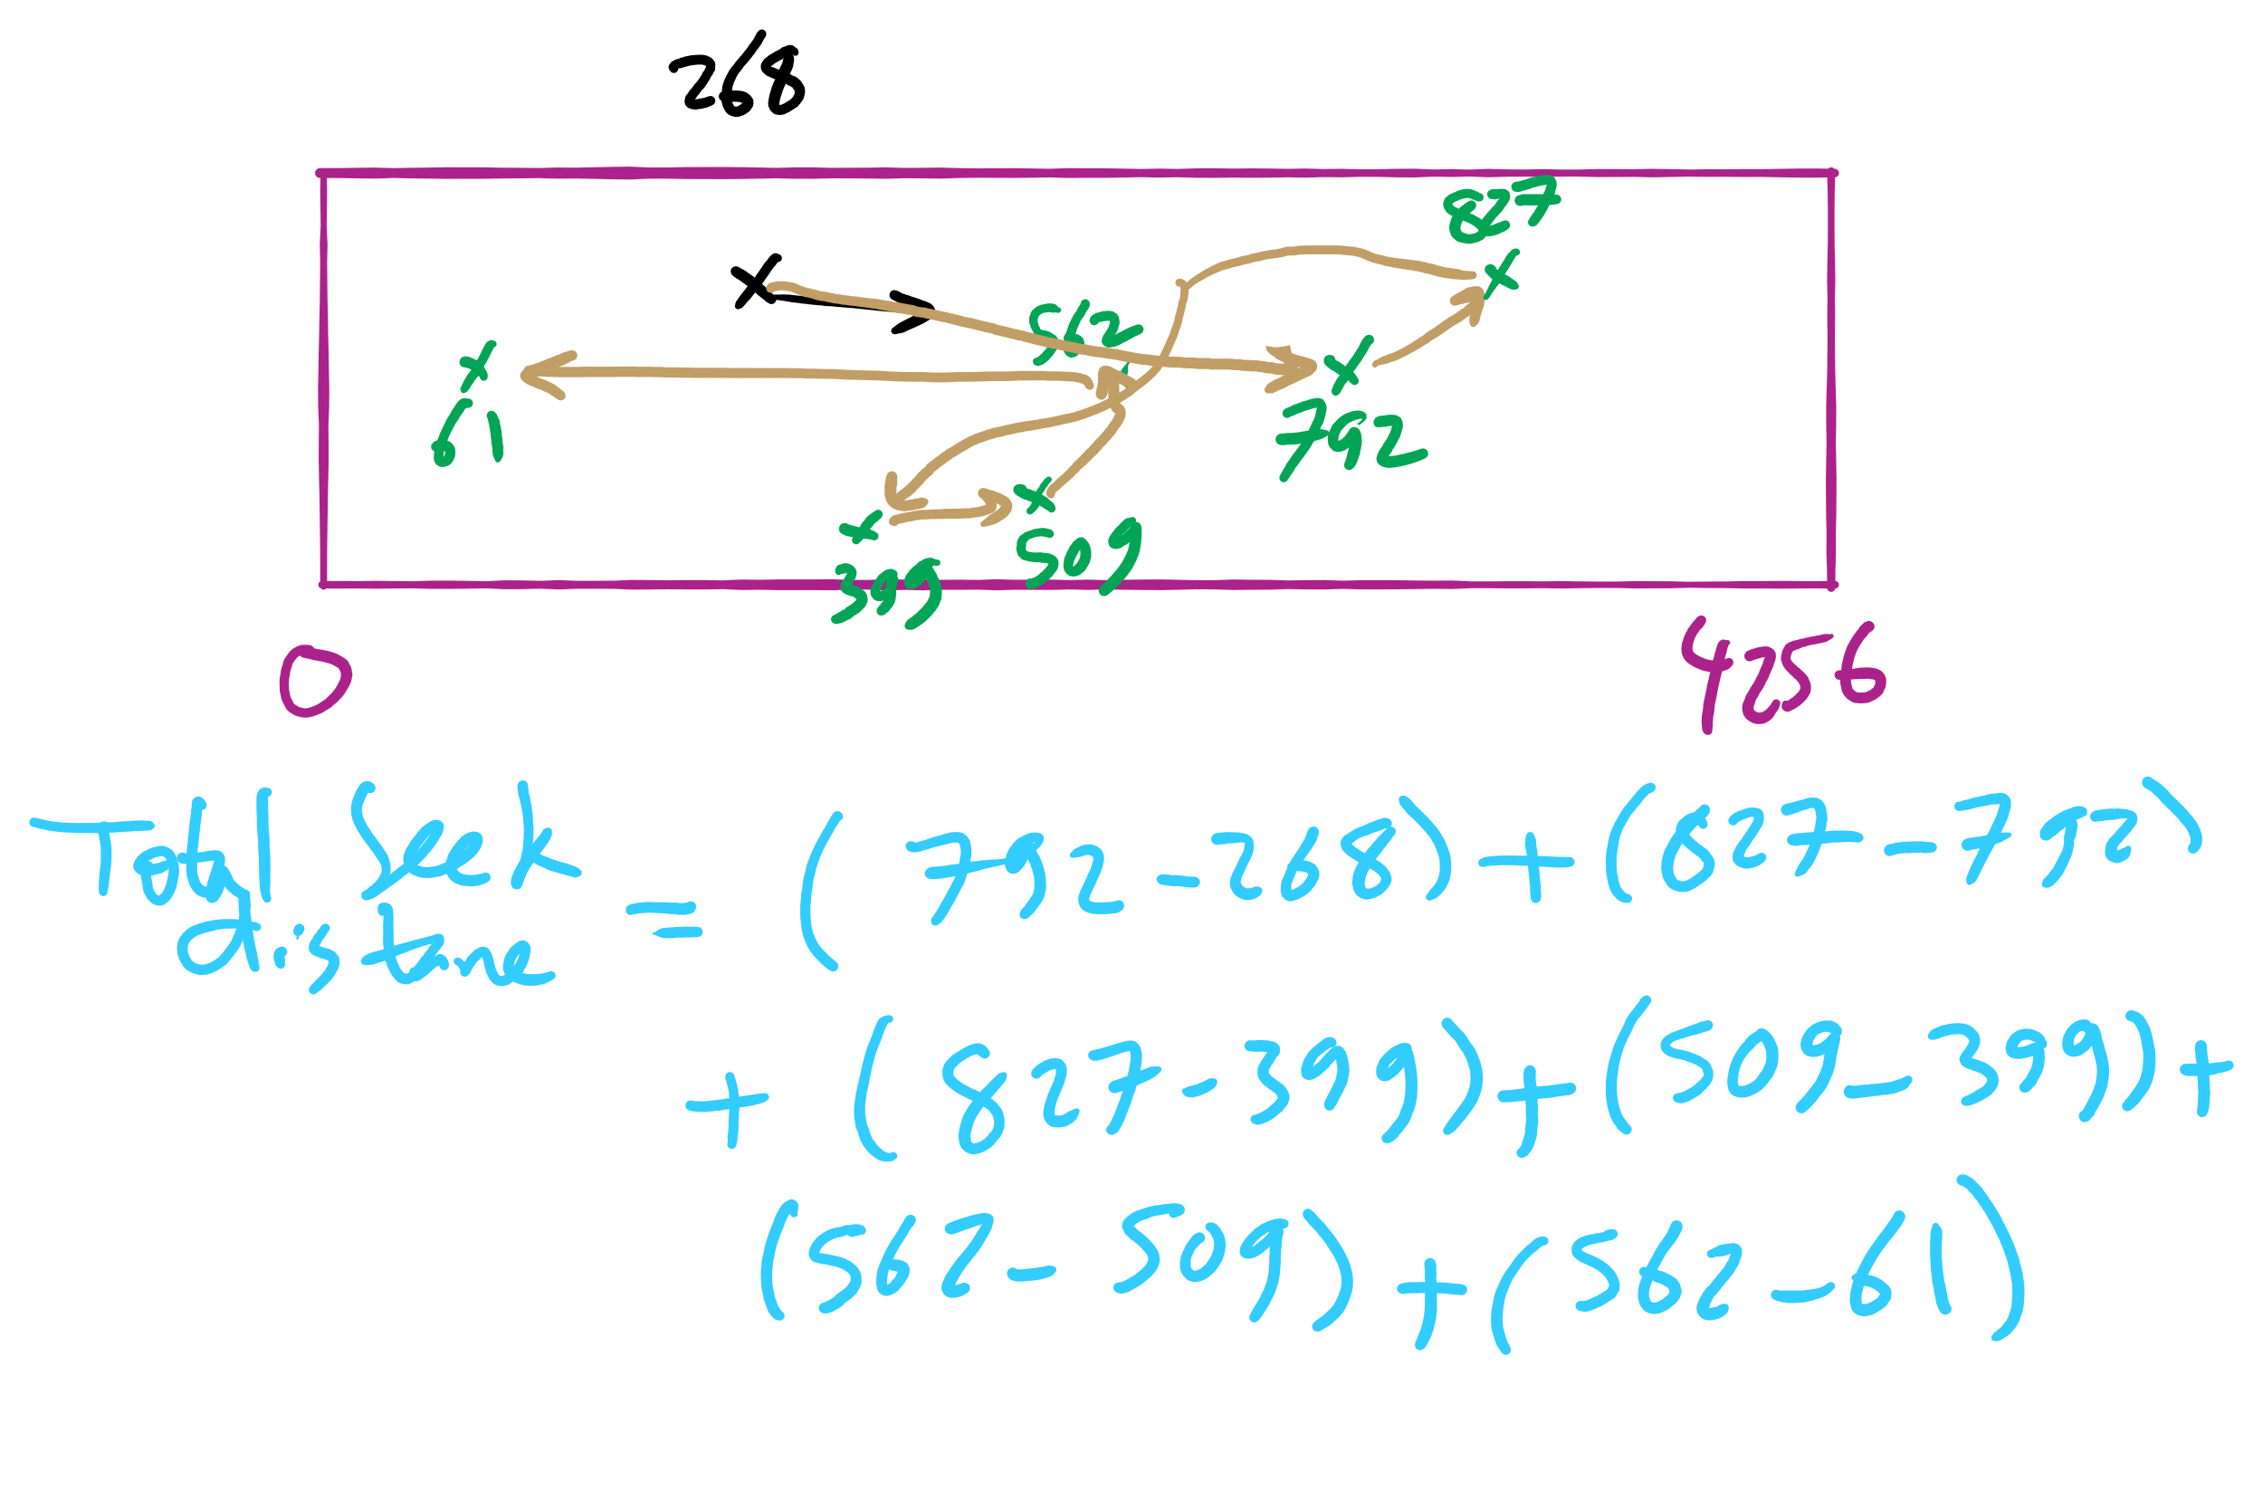
FCFS Example 2

Slide 39
Shortest Seek Time First (SSTF)
Service the request with the shortest seek time from the current head position
Form of SJF scheduling
May starve some requests
Seek order = 73, 77, 100, 133, 140, 175, 51, 8
Seek distance = 10 + 4 + 23 + 33 + 7 + 35 + 124 + 43 = 279 cylinders
read/write head start
73
77
51
8
133
100
140
175

Slide 40
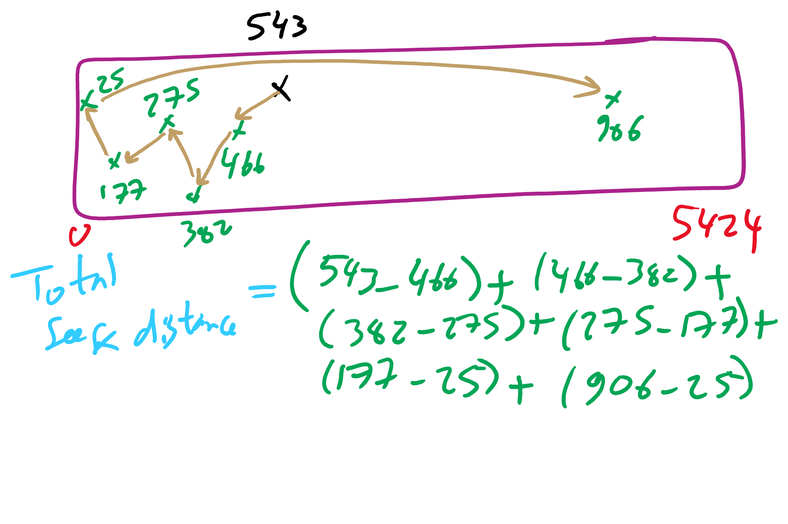
SSTF Example 2

Slide 41
SCAN (elevator algorithm)
Disk arm starts at one end of the disk and moves towards the other end, servicing requests as it goes
Reverses direction when it gets to end of the disk
Also known as elevator algorithm
Seek order = 51, 8, 0 , 73, 77, 100, 133, 140, 175
Seek distance = 12 + 43 + 8 + 73 + 4 + 23 + 33 + 7 + 35 = 238 cyls
read/write head start
51
8
73
77
100
133
140
175

Slide 42
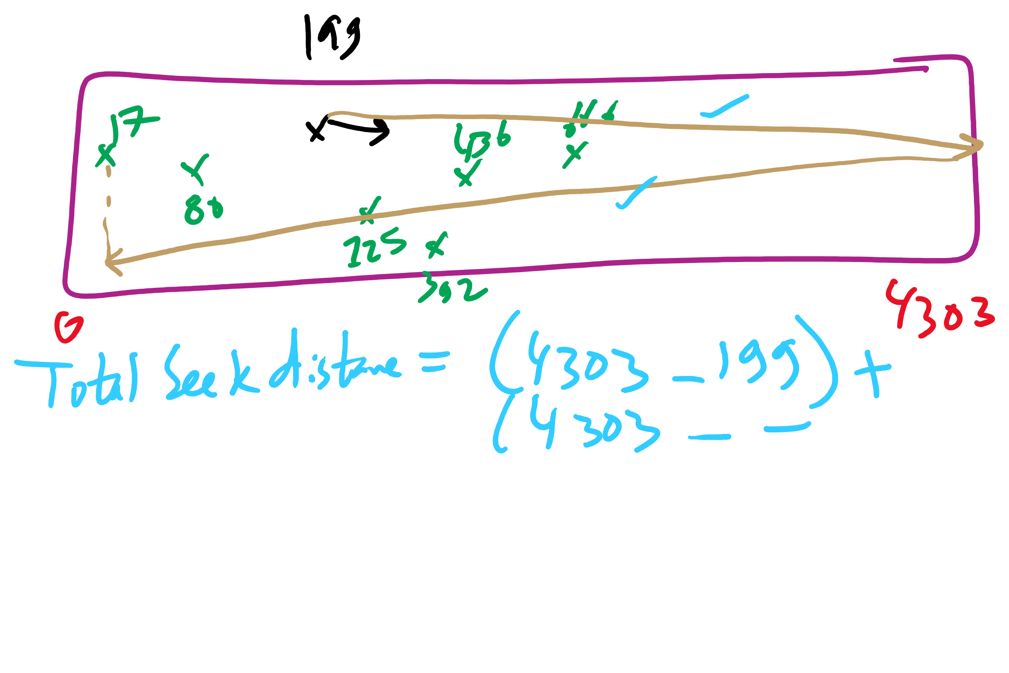
SCAN Example 2

Slide 43
C-SCAN
Identical to SCAN, except head returns to cylinder 0 when it reaches the end of the disk
Treats cylinder list as a circular list that wraps around the disk
Waiting time is more uniform for cylinders near the edge of the disk
Seek order = 73, 77, 100, 133, 140, 175, 199, 0, 8, 51
Distance = 10 + 4 + 23 + 33 + 7 + 35 + 24 + 199 + 8 + 43 = 386 cyls
read/write head start
73
77
100
133
140
175
8
51

Slide 44
C-LOOK
Identical to C-SCAN, except head only travels as far as the last request in each direction
Saves seek time from last sector to end of disk
Seek order = 73, 77, 100, 133, 140, 175, 8, 51
Distance = 10 + 4 + 23 + 33 + 7 + 35 + 167 + 43 = 322 cylinders
read/write head start
73
77
100
133
140
175
8
51

Slide 45
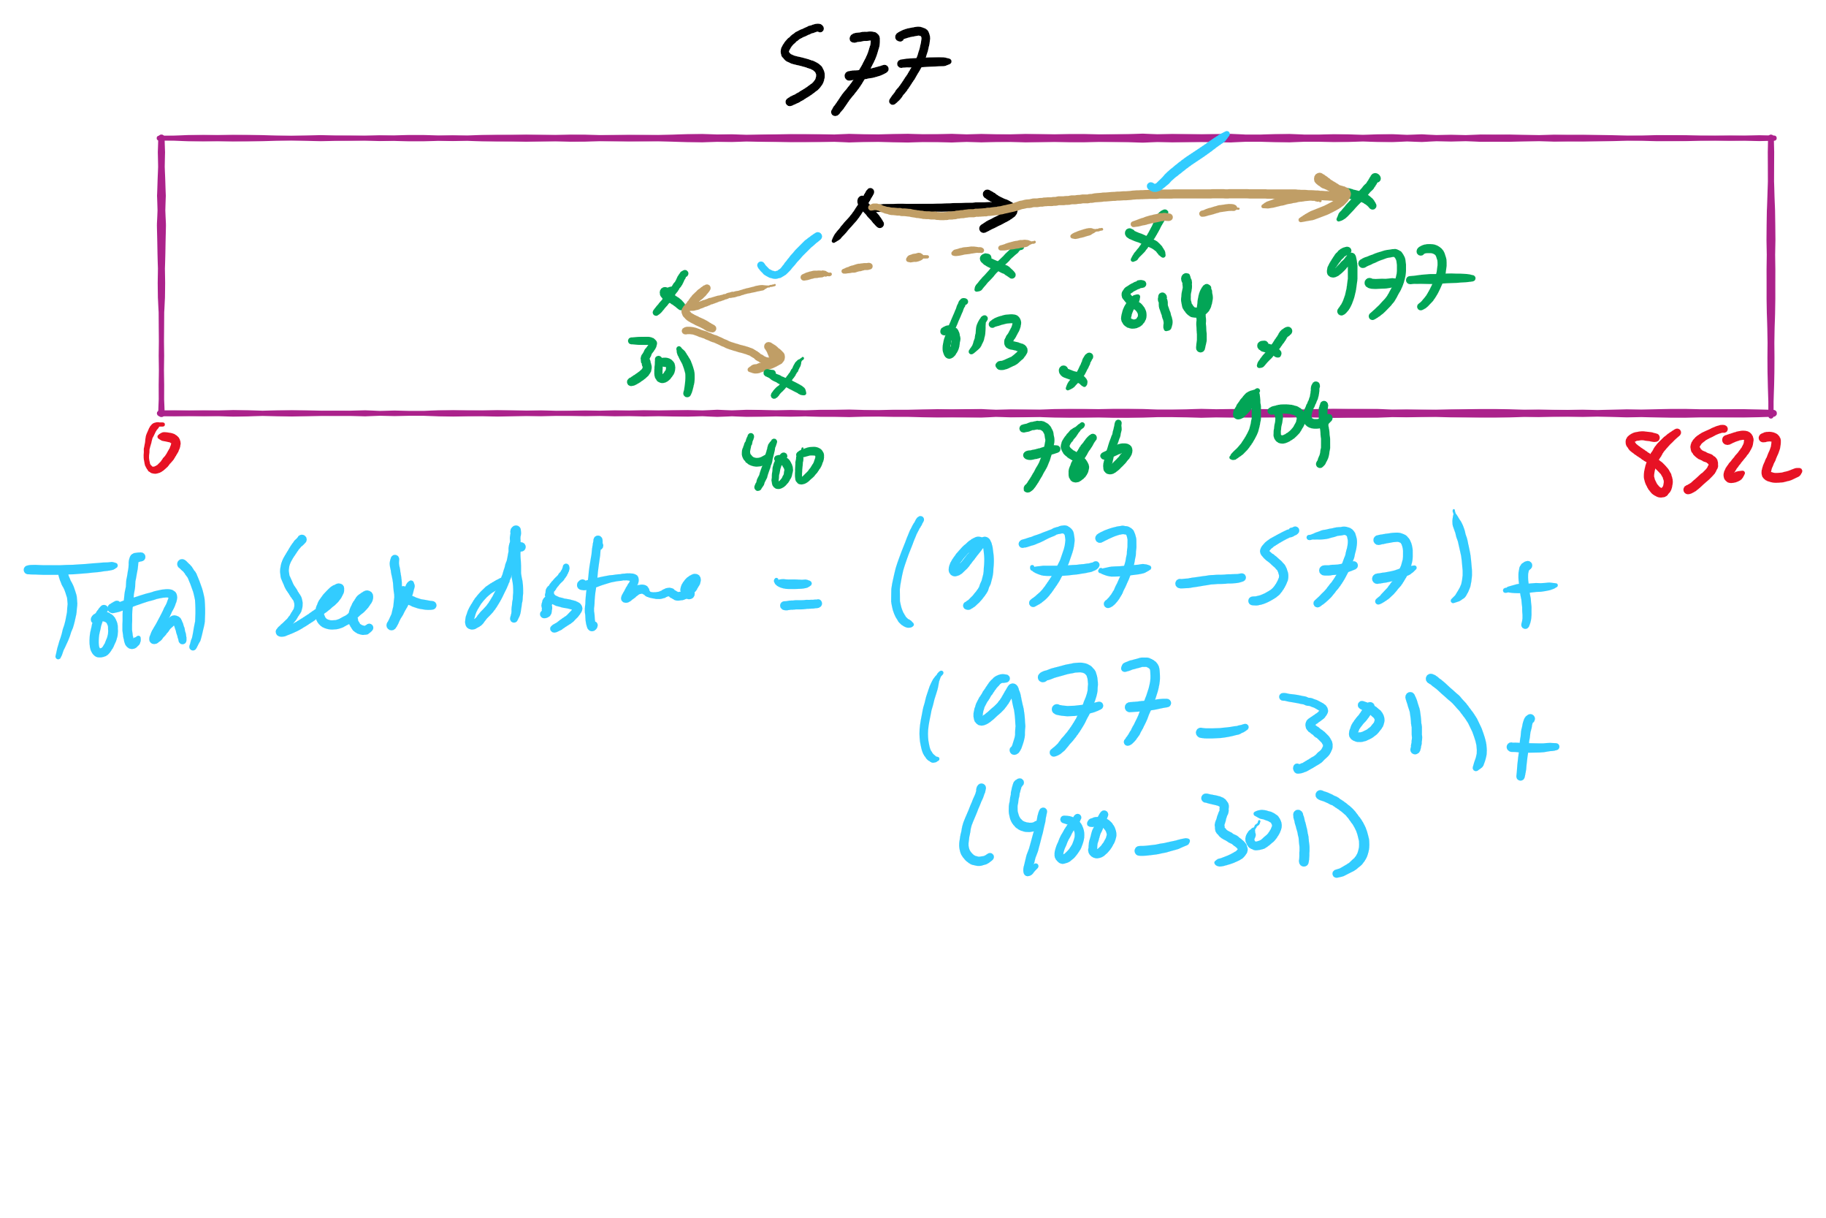
C-LOOK Example 2

Slide 46
Miscellaneous Issues
File Sharing
Journalling File System
I/O Buffering
More Kernel-level data structures

Slide 47
Hierarchical directory system
Root directory
A
B
C
A
Papers
A foo
A
Photos
B foo
B
Papers
C bar
C foo
C blah
A os.tex
A sunset
A
Family
B foo.tex
B foo.ps
A sunset
A kids
A Mom

Slide 48
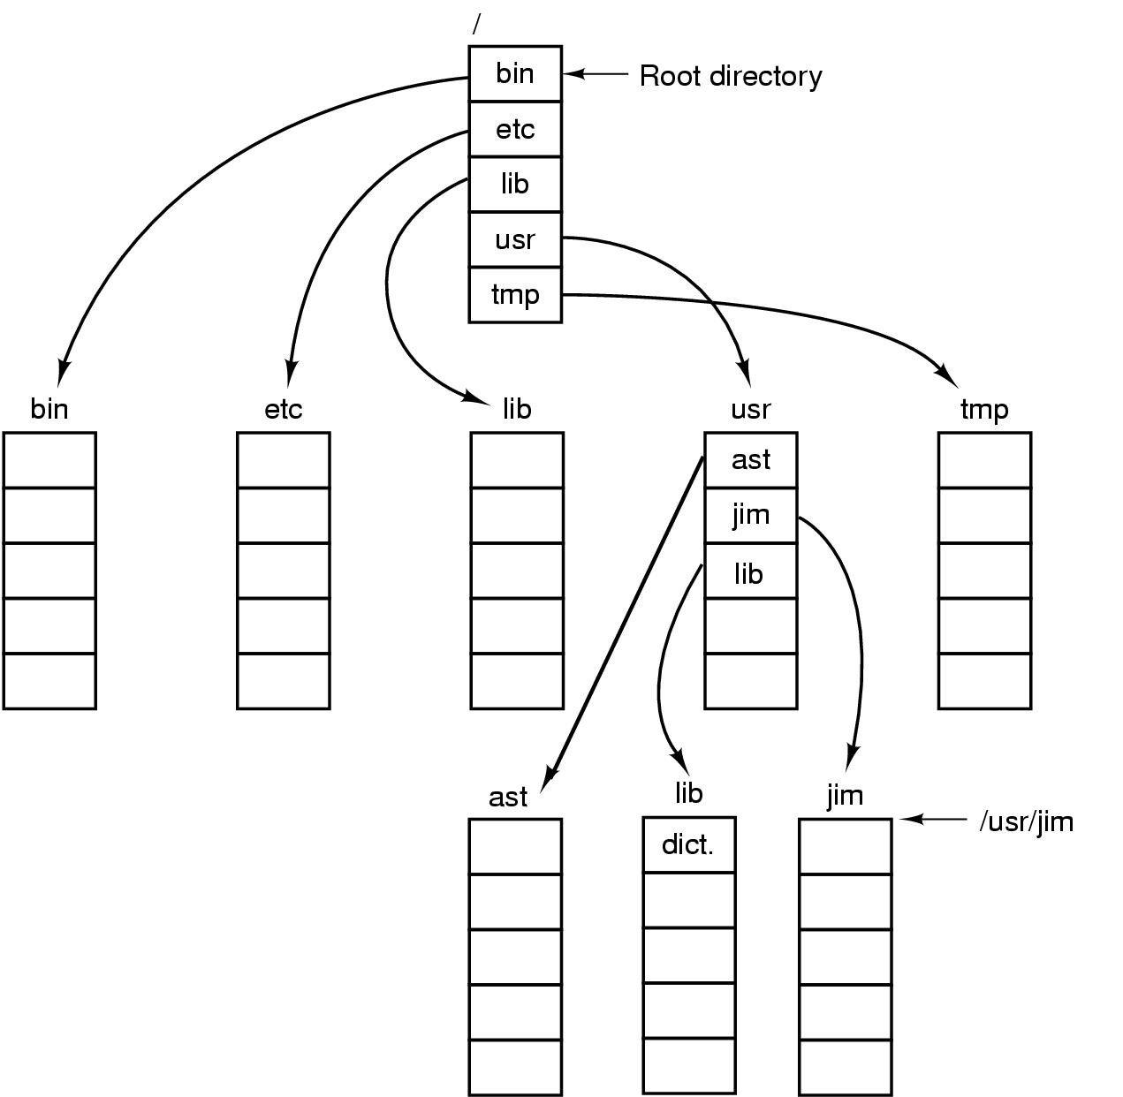
Unix directory tree

Slide 49
Sharing files
Root directory
A
B
C
A
Papers
A foo
A
Photos
B foo
B
Photos
C bar
C foo
C blah
A os.tex
A sunset
A
Family
B lake
A sunset
A kids
? ???

Slide 50
Solution: use links
A creates a file, and inserts into her directory
B shares the file by creating a link to it
A unlinks the file
B still links to the file
Owner is still A (unless B explicitly changes it)
A
A
B
B
b.tex
b.tex
a.tex
a.tex
Owner: A Count: 1
Owner: A Count: 2
Owner: A Count: 1

Slide 51
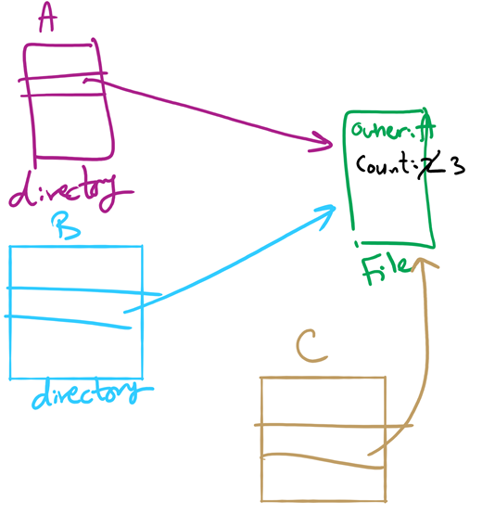
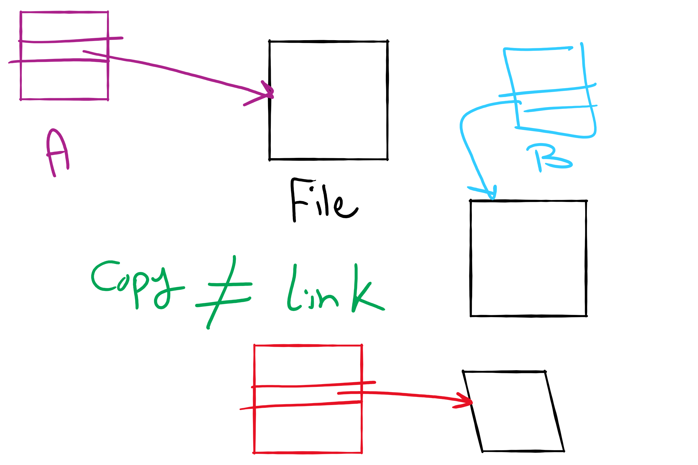
File Linking (left) vs. File Copying (right)

Slide 52
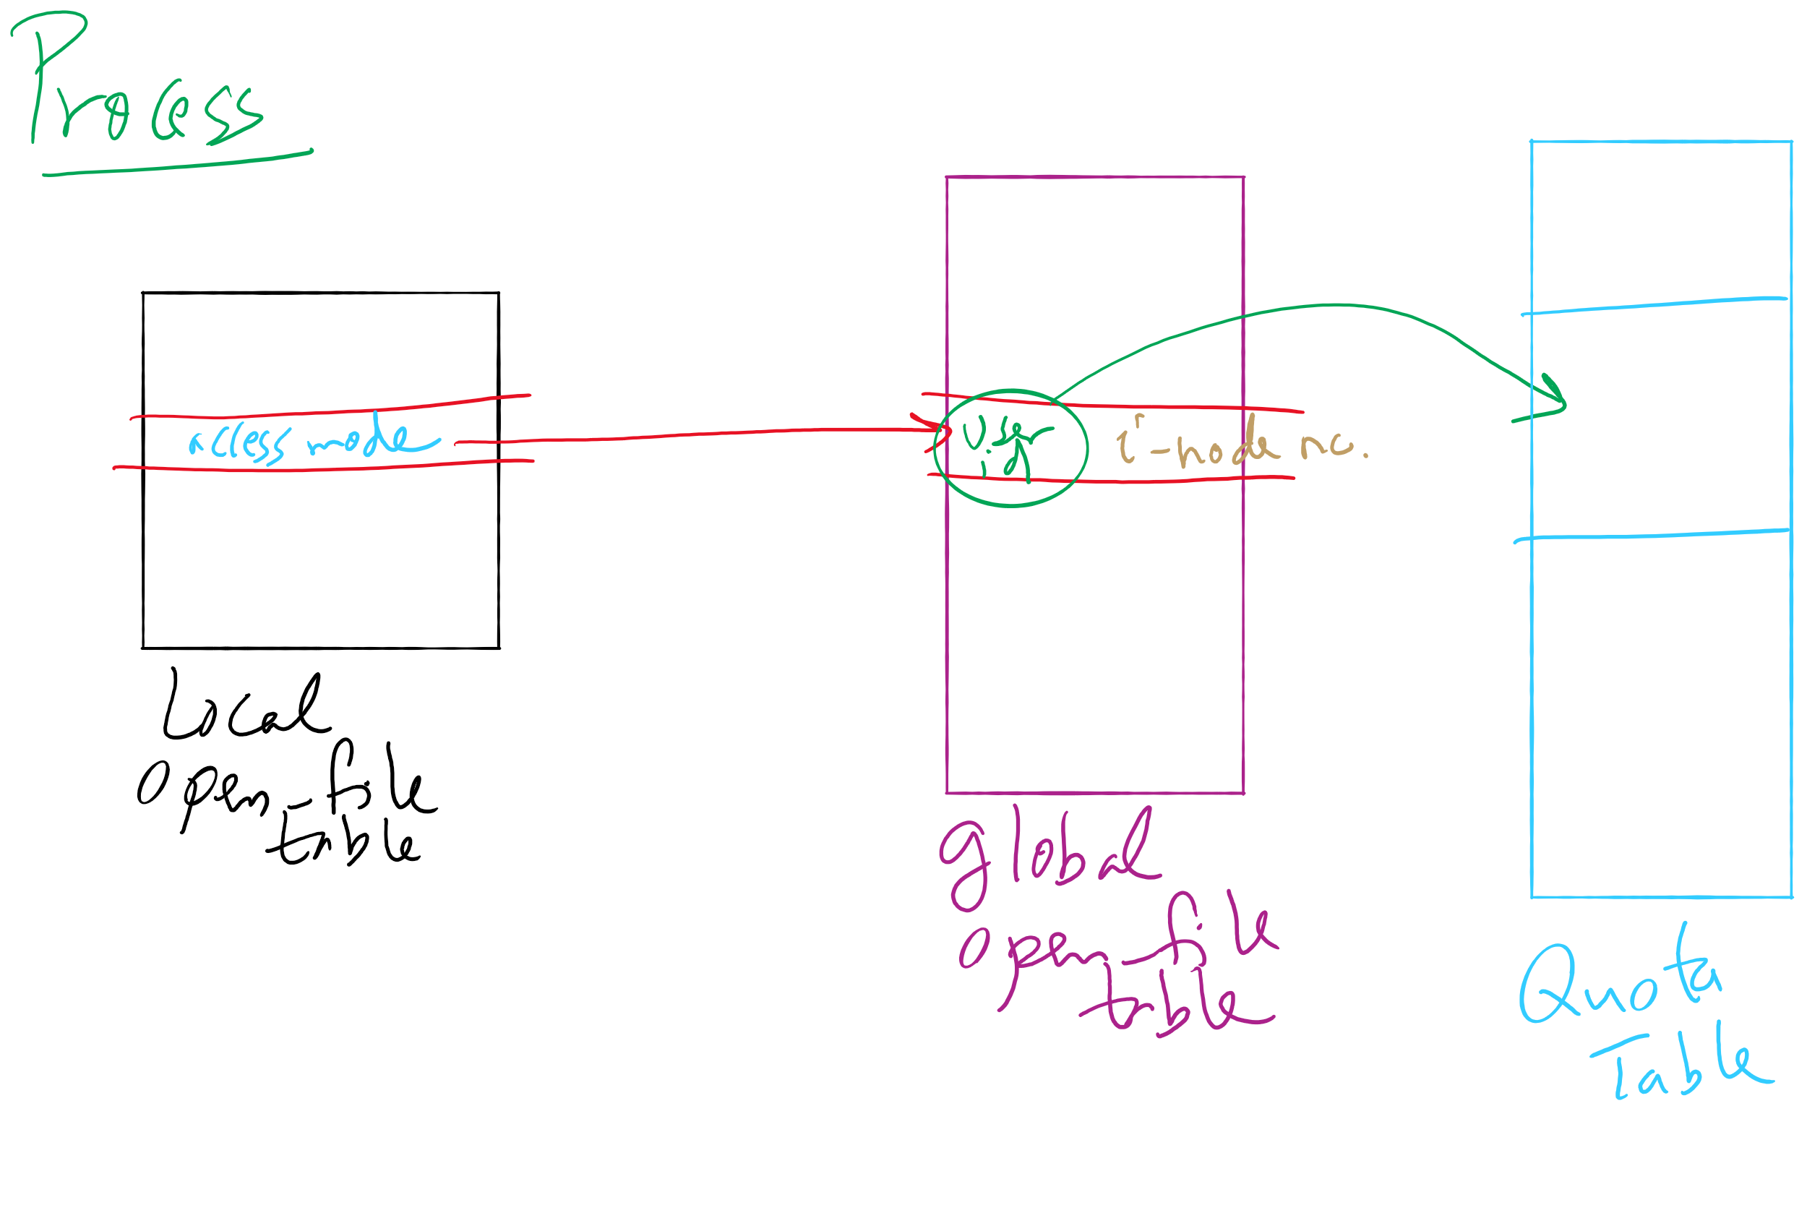
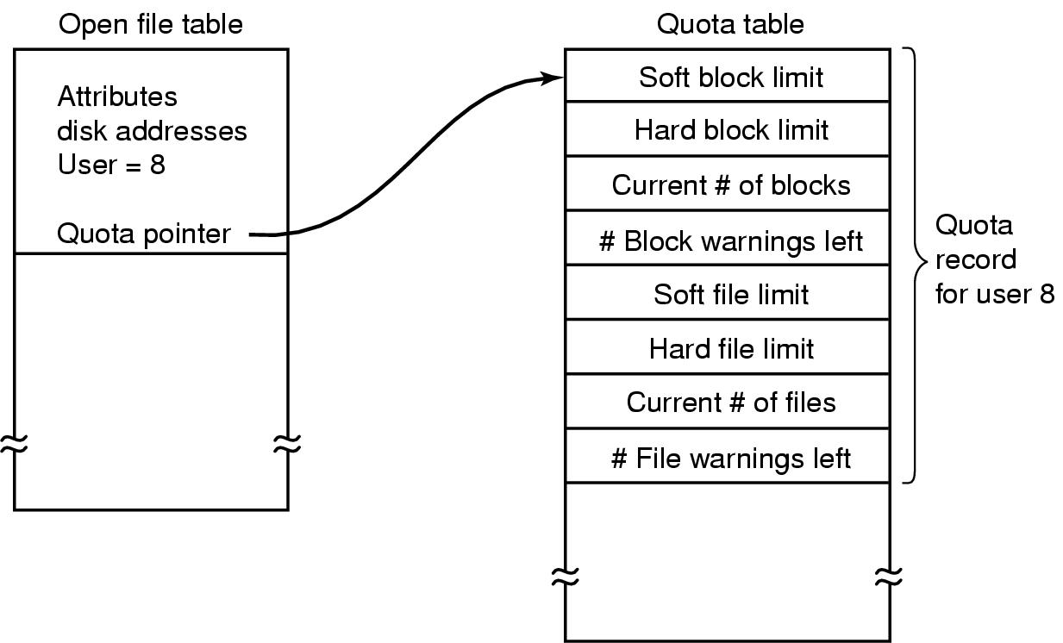
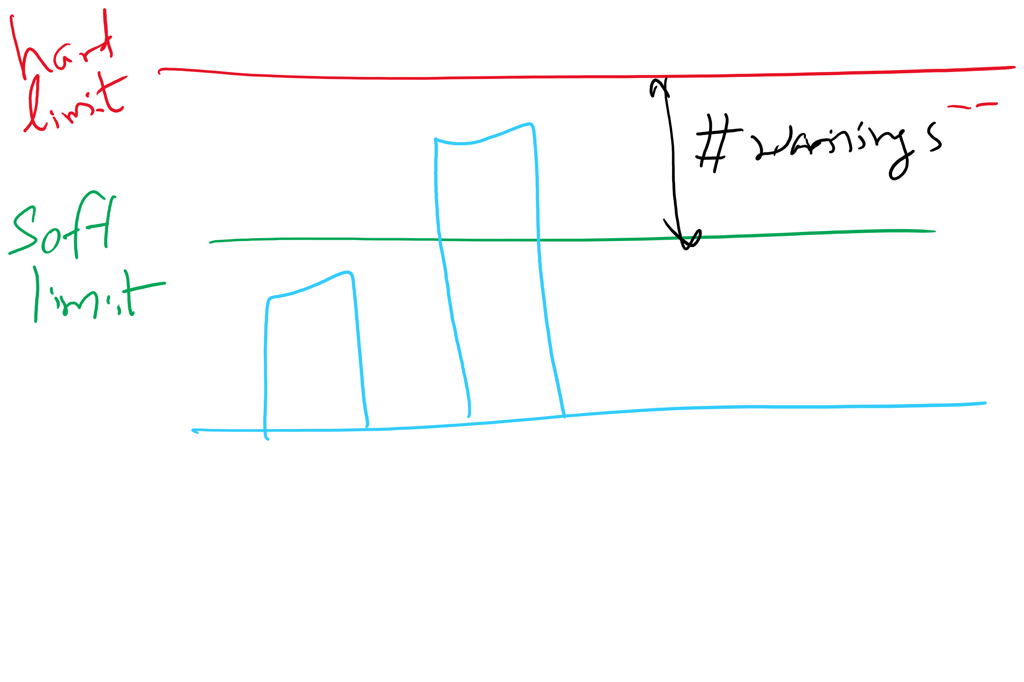
File-related kernel structures: open file tables and disk quotas

Slide 53
Journaling File System
In a regular file system, changes to files and directories result in multiple separate writes to disk
prone to power failures
Write the changes twice
first to an on-disk journal
for efficiency, journal can be put on SSD or NVRAM
modified data itself may or may not be written to the journal
second to main file system
Examples
Windows NTFS
Linux ext3, ext4

Slide 54
Journaling File System
Interaction of disk arm scheduling?
out-of-order writes
ext3 and ext4 force disk to flush its cache at certain points (barriers)
Journaling vs. Log-structured file system
Journaling is not needed in LFS

Slide 55
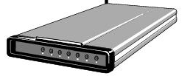
Buffering device input
User space
User space
User space
User space
Kernel space
Kernel space
Kernel space
Kernel space
2
2
1
1
3
Unbuffered input
Buffering in user space
Buffer in kernel Copy to user space
Double buffer in kernel

Slide 56
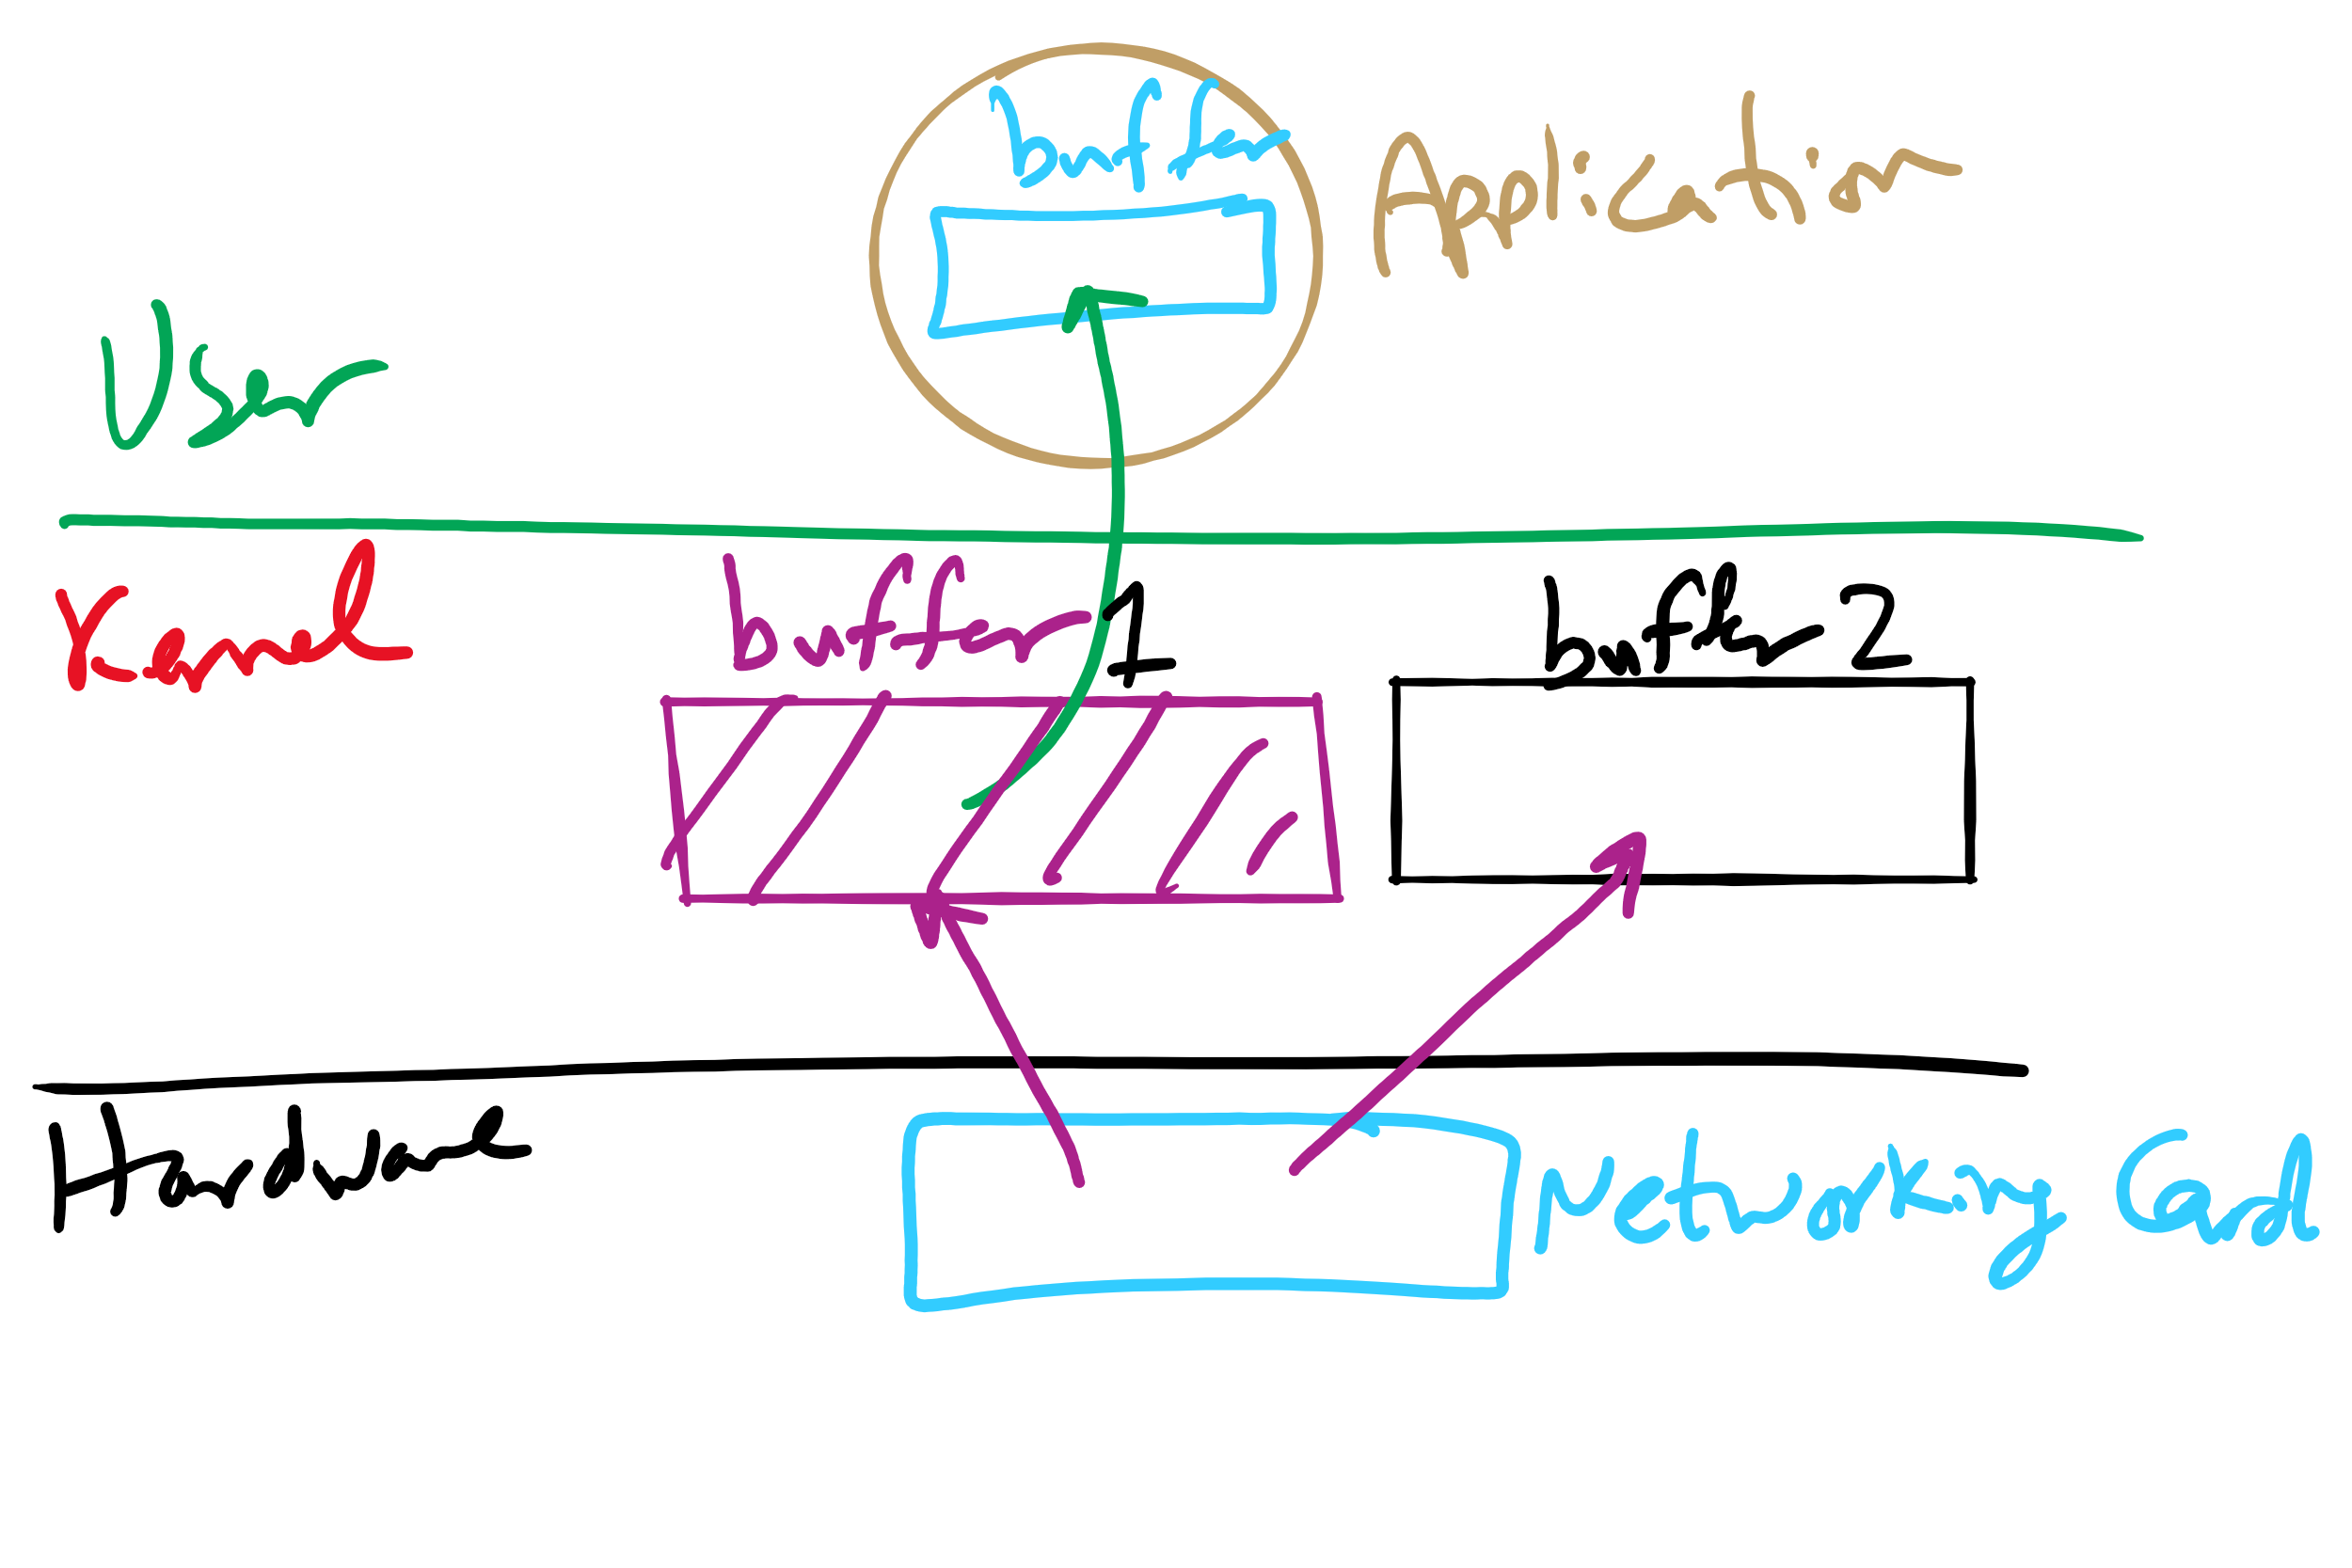
I/O Buffering

Slide 57
Max Partition Size
Block size | FAT-12 | FAT-16 | FAT-32
0.5 KB | 2 MB
1 KB | 4 MB
2 KB | 8 MB | 128 MB
4 KB | 16 MB | 256 MB | 1 TB
8 KB |  | 512 MB | 2 TB
16 KB |  | 1024 MB | 2 TB
32 KB |  | 2048 MB | 2 TB

Slide 58
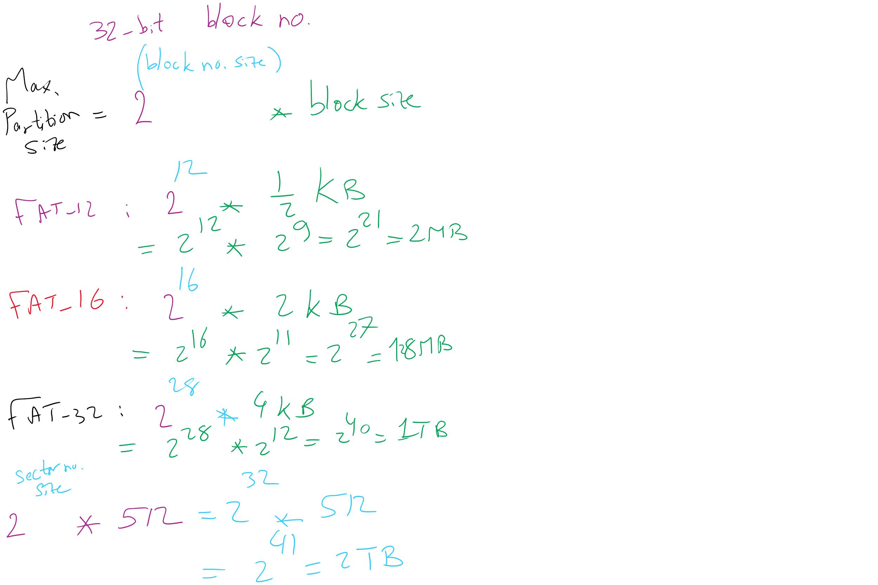
Max Partition Size

Slide 59
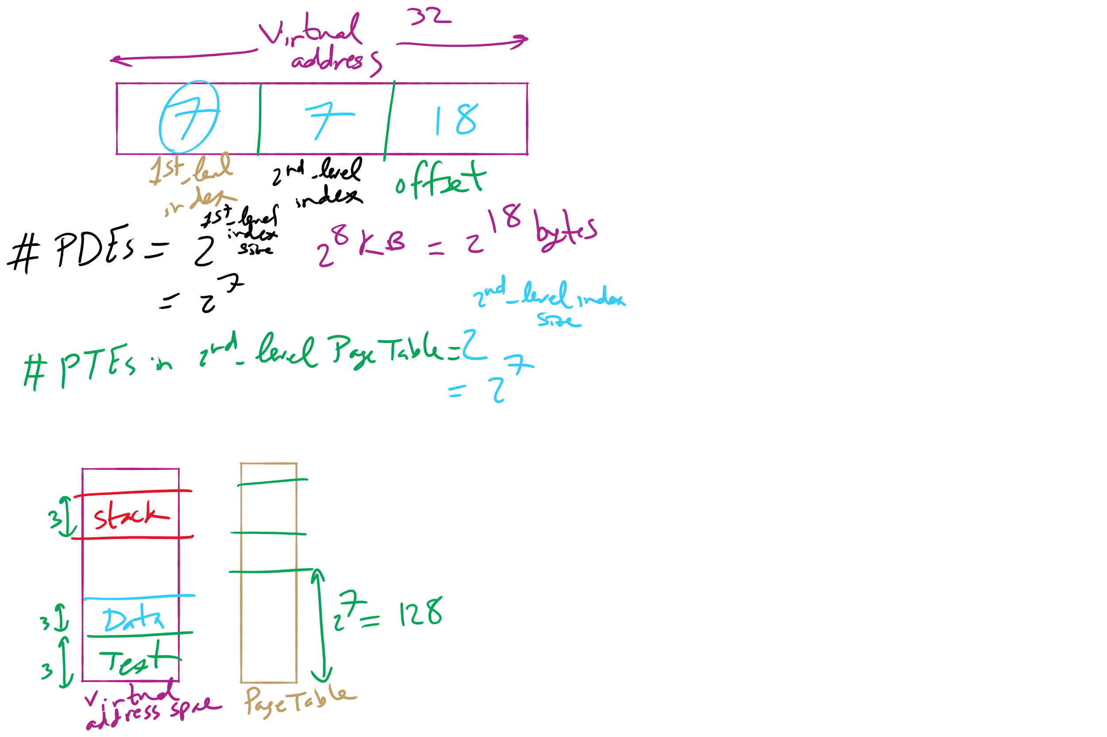
HW 10: Q 2-4

Slide 60
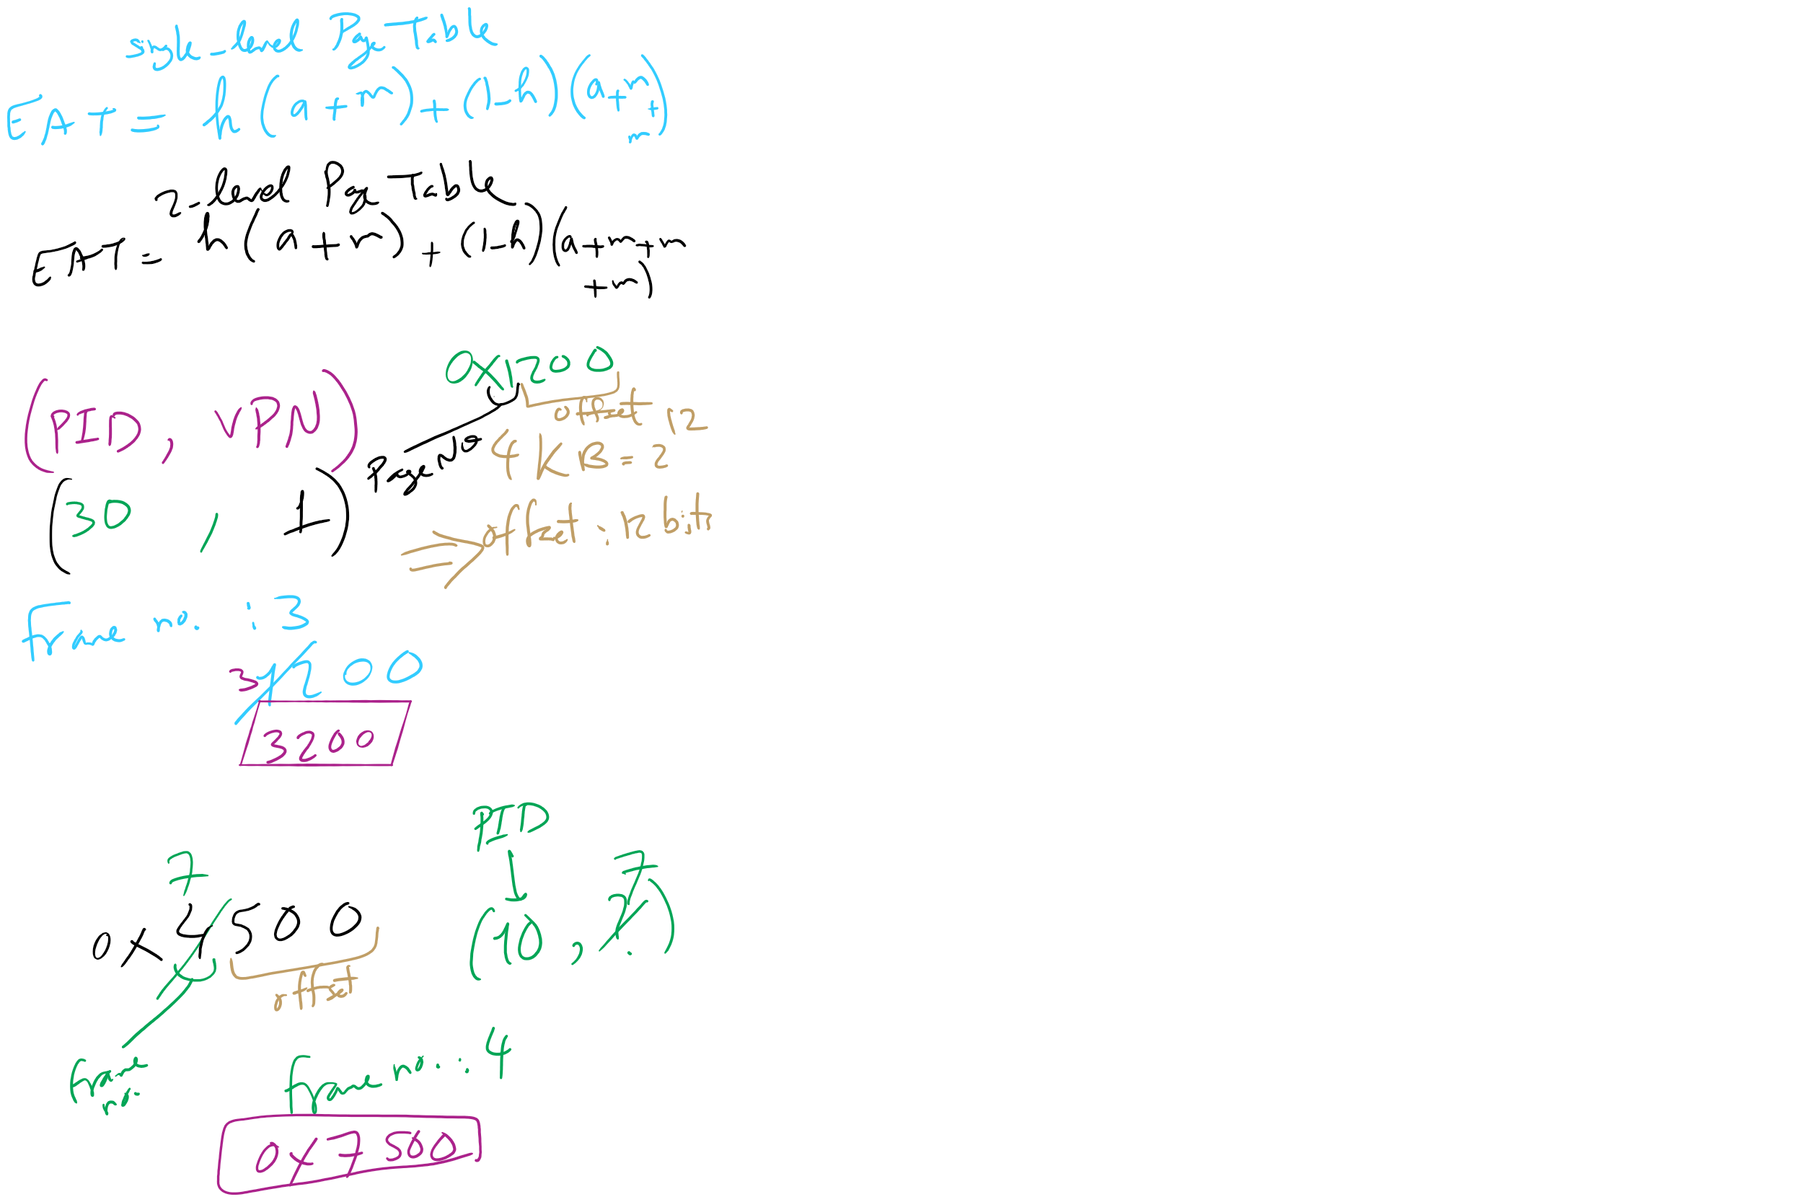
HW 10: Q 10-13

Slide 61
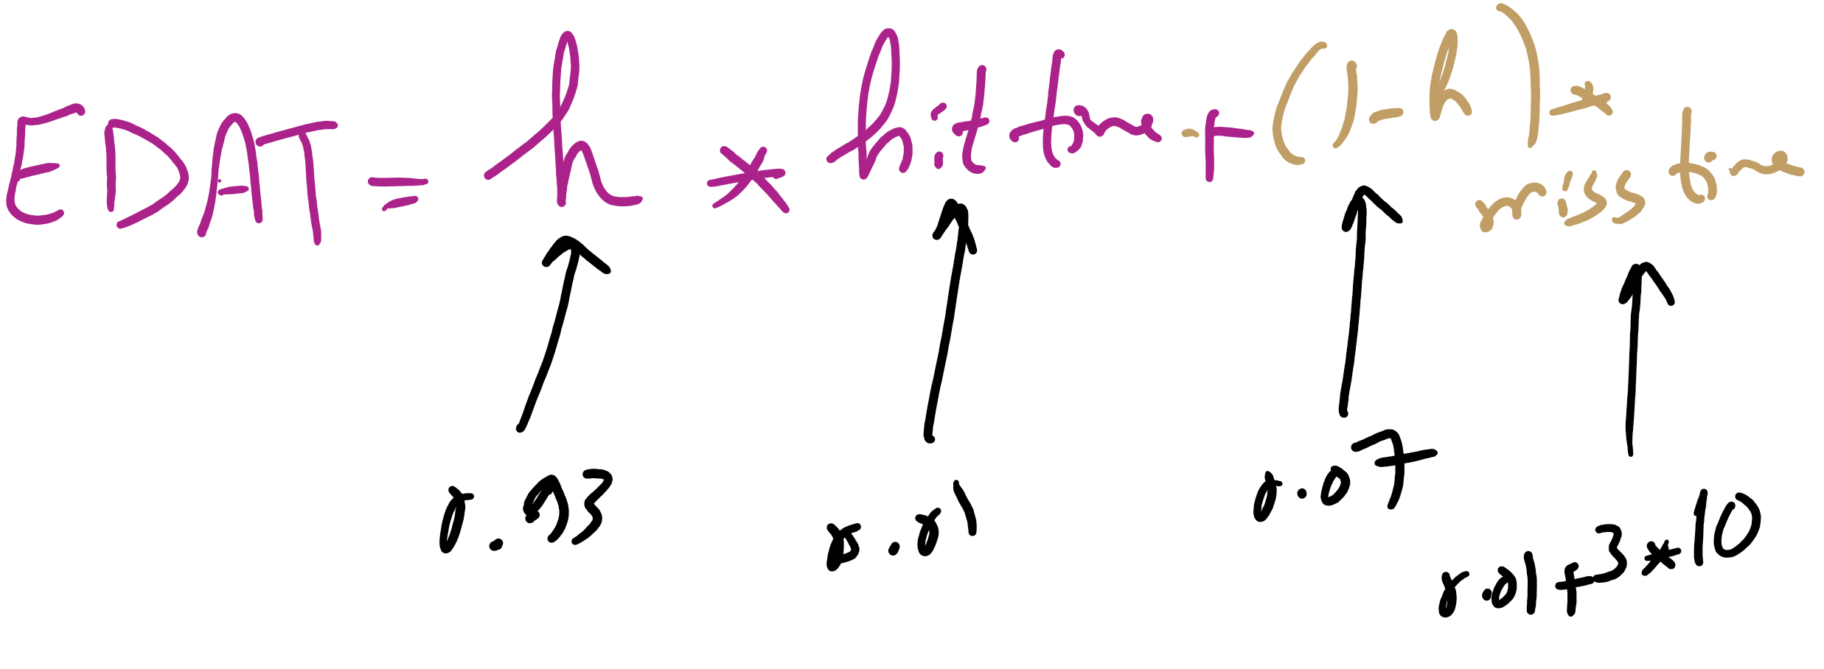
Effective Disk Access Time

Slide 62
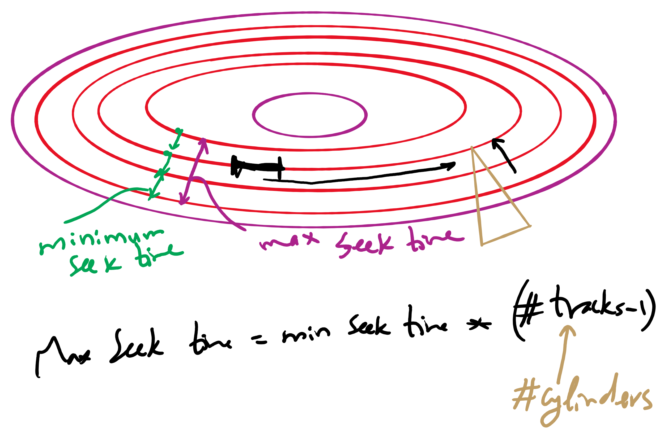
Minimum and Maximum Seek Time

Slide 63
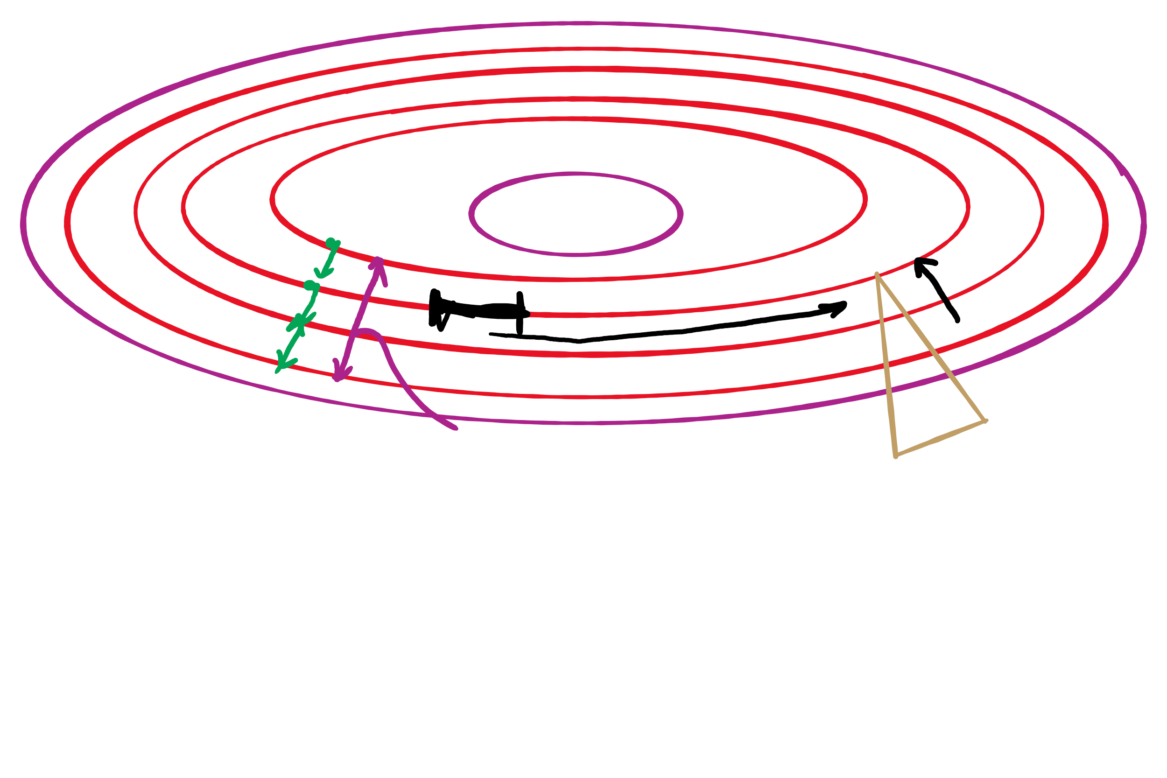
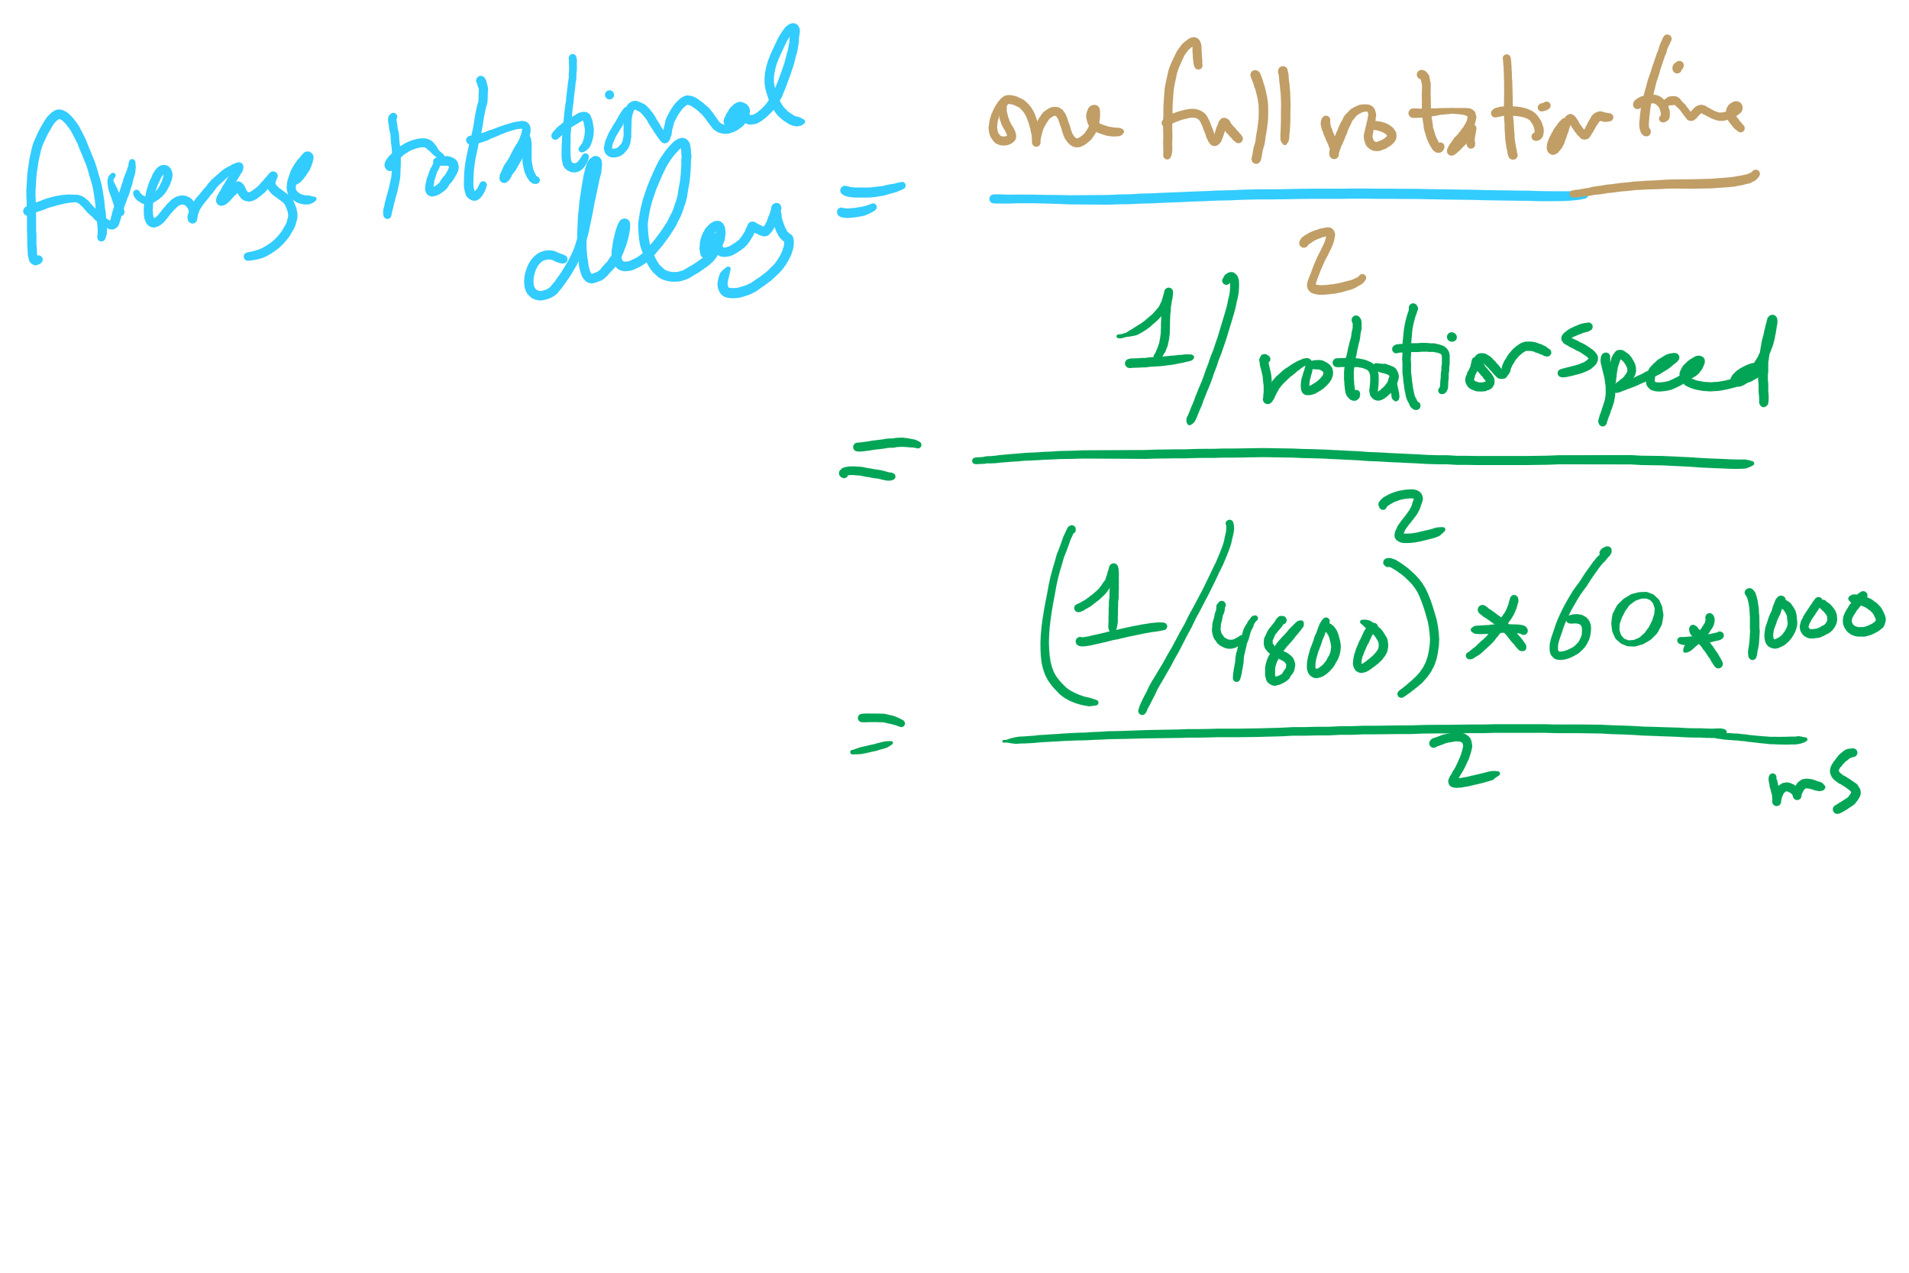
Average Rotational Delay

